Slide 1
Closest Location
Ashwin Khatwa

Slide 2
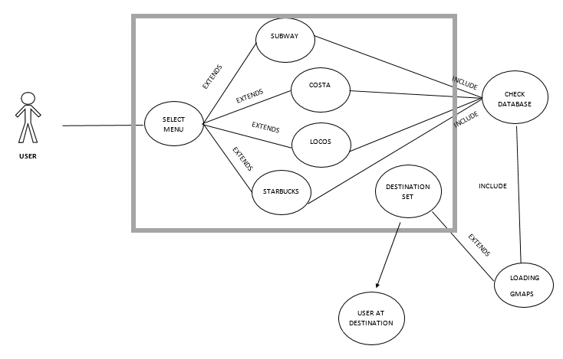
Use case diagram

Slide 3
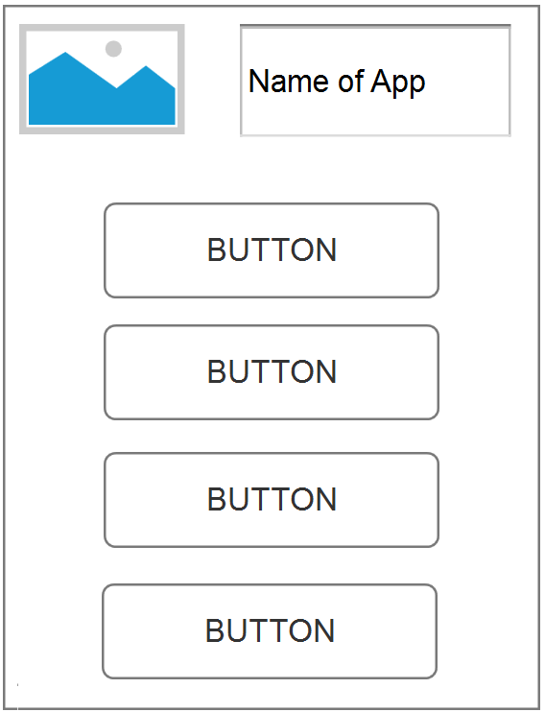
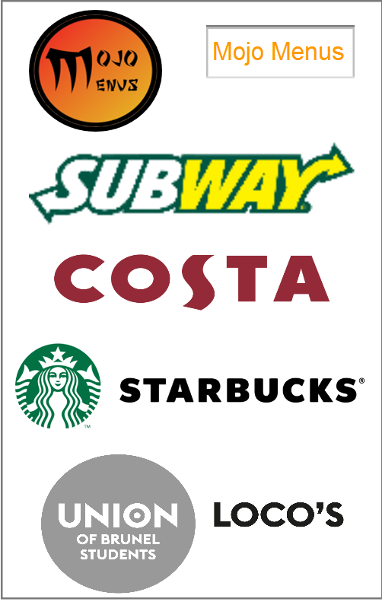
Axure Concept

Slide 4
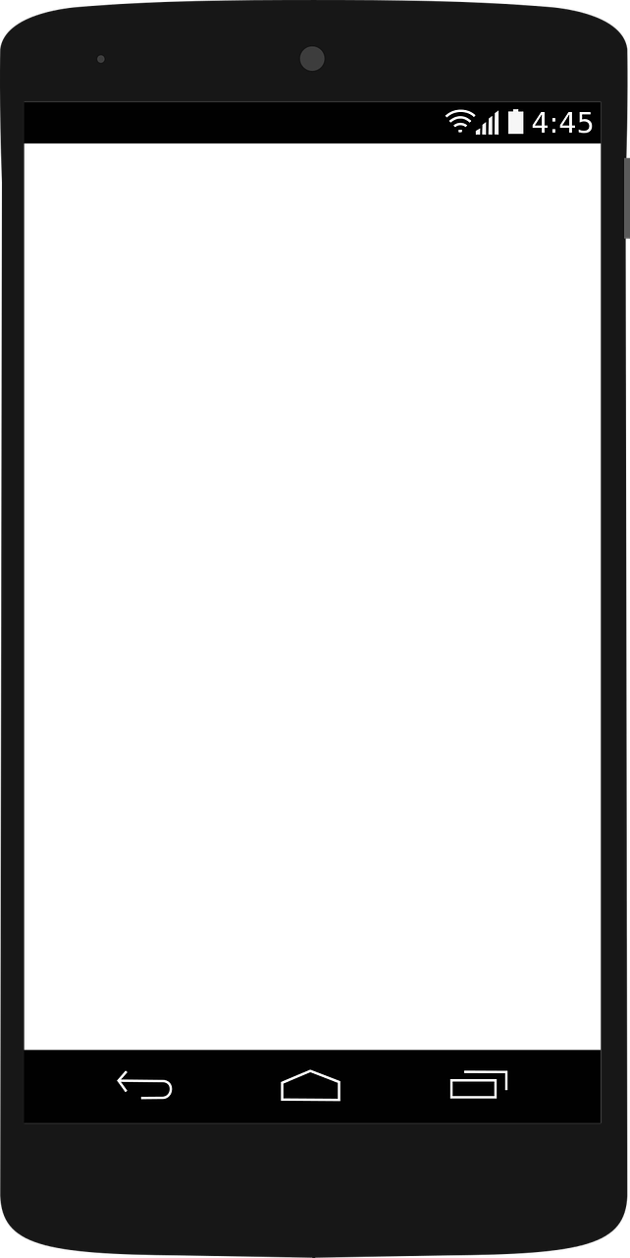
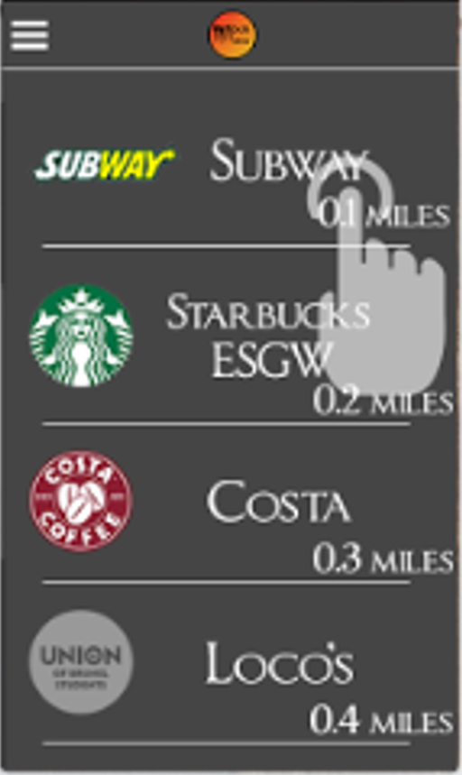
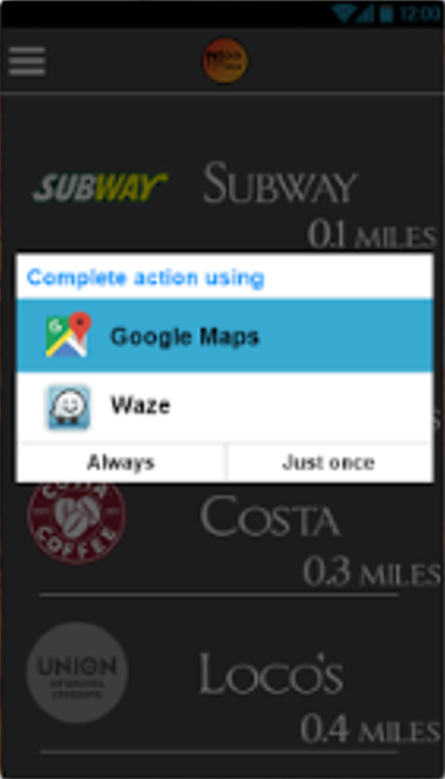
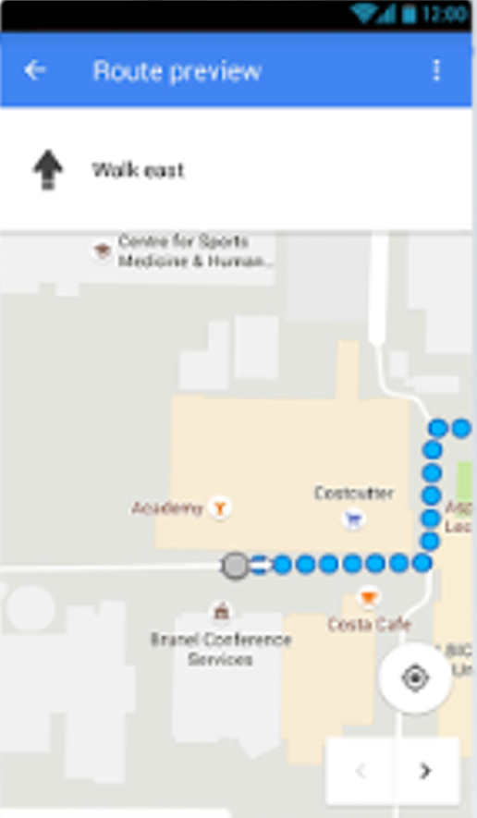
Final Design: Closest location
The user will be taken to their chosen location based app and be given the directions to their chose menu
The user will select which “menu” they want to go to
The closest location will be listed at the top
If the user has more than one location based app they will be given the option which one they like to use

